Slide 1






Implementing Routing and Switching Network in AWS using CentOS Server Administration
16 Oct, 2024

Slide 2
Team -
Anuja Dixit
Anmol Baghel
Mansi Singh
Gaurav Gupta
K Dushyant Reddy
Mainak Roy
Guided by-
Zakir Hussain

Slide 3


TABLE OF CONTENT
01
Overview
05
EC2 & Instances
02
Architecture
06
Testing
03
Tools & Services
07
RDS & Read Replica
04
VPC & Transit gateways
08
Monitoring & Billing
09
Future Scope
10
Conclusion

Slide 4
OVERVIEW
This project implements routing and switching network in AWS using CentOS server administration. Two VPCs with public and private subnets are connected using a Transit Gateway. EC2 instances are deployed in both VPCs, with each instance hosting an HTML page. Routing between the VPCs is verified by successfully pinging from an EC2 instance in one VPC to another instance in the second VPC. Load balancers manage traffic between instances, while AMI snapshots ensure easy instance replication. Monitoring and management tools like Systems Manager, CloudWatch, and VPC Flow Logs are used for performance tracking, and cost management is handled through Budget, Cost Explorer, and SNS alerts.

Slide 5
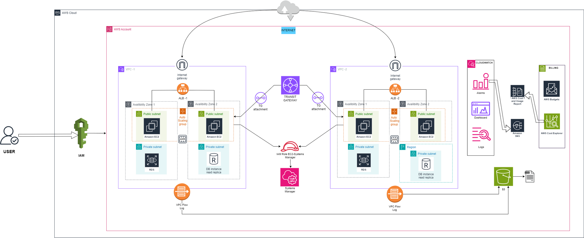
Architecture

Slide 6
Tools & Services
01
IAM
05
09
RDS-MySQL
Cost Explorer
02
VPC
06
10
Budgets
EC2
03
07
Systems Manager
Transit Gateway
11
VPC Flow logs
04
08
12
AMI-CentOS GUI RDP
CloudWatch
S3

Slide 7

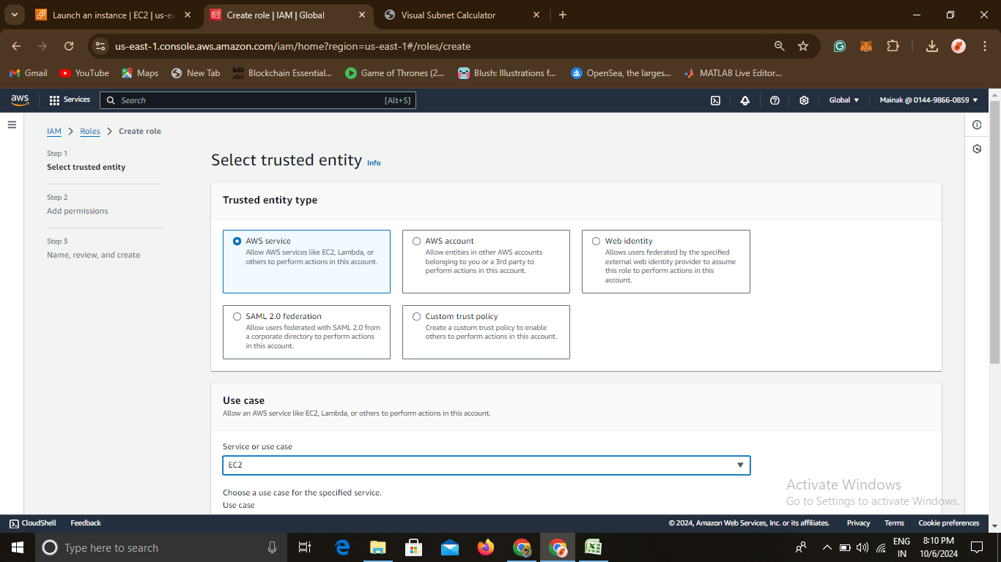
IAM
IAM Users
IAM was used to create individual user accounts for all group members, assigning specific roles to each member to manage permissions and tasks. This ensured secure access control, enabling efficient collaboration while maintaining security best practices within the AWS environment.

Slide 8
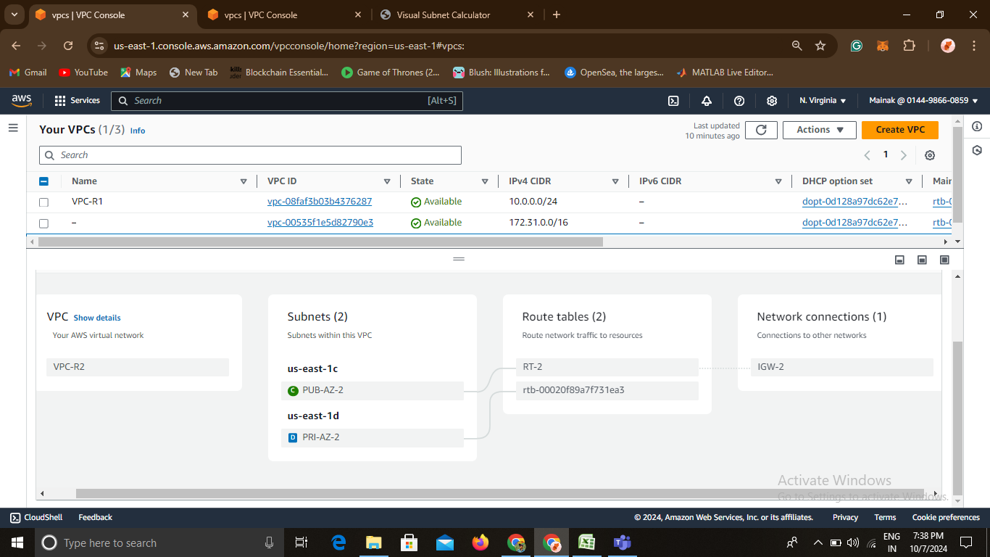
VPC
VPC-R1 &VPC-R2
A Virtual Private Cloud (VPC) is a logically isolated section of the AWS cloud where you can define your own IP address ranges, subnets, route tables, and gateways. In this project, two VPCs were created, each containing both public and private subnets.
Public Subnets: These are connected to the internet via an Internet Gateway (IGW)
Private Subnets: These are isolated from the internet and used for internal resources like databases.

Slide 9
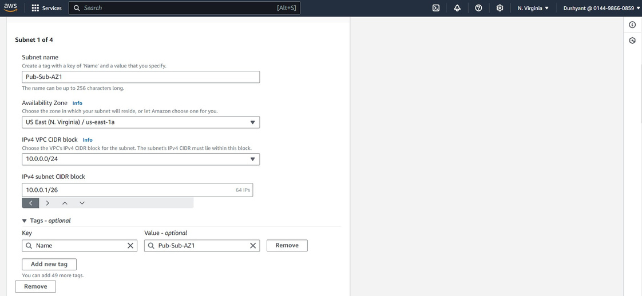
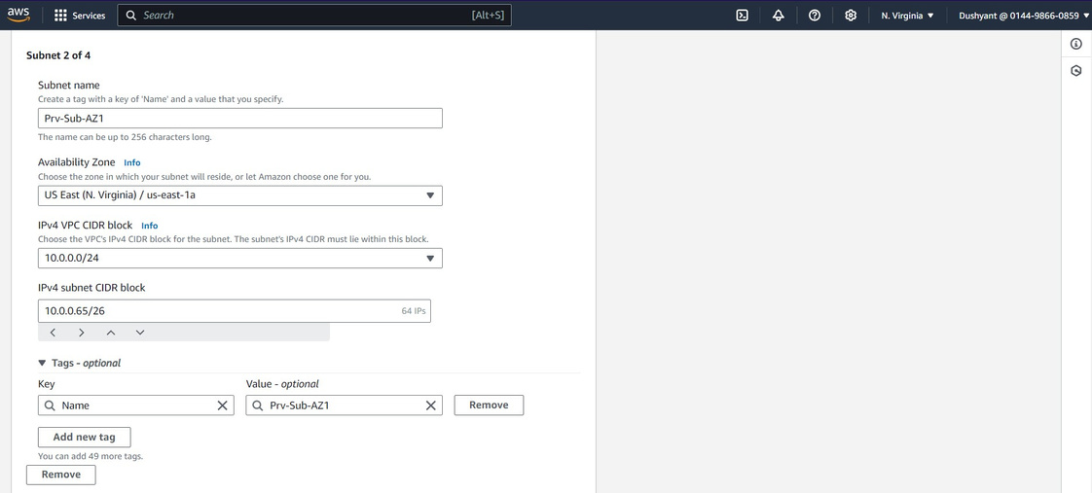
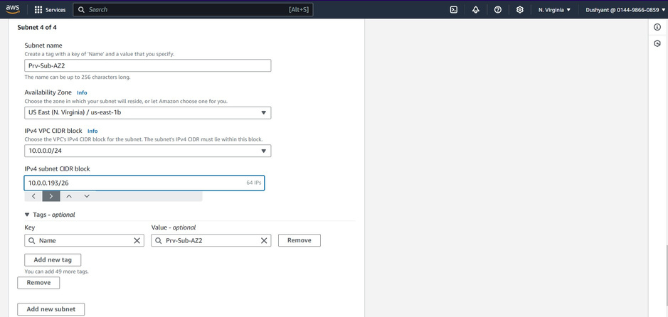
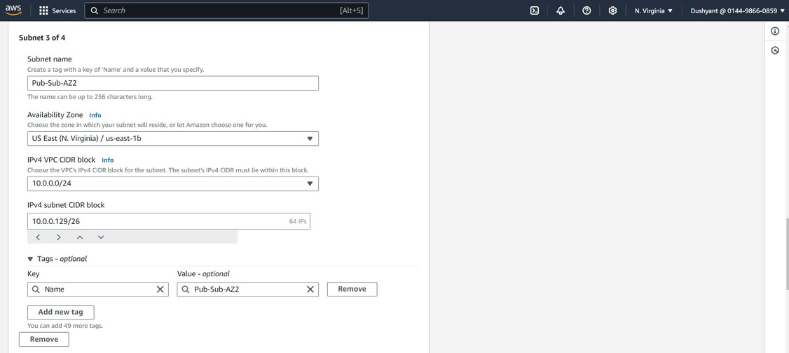
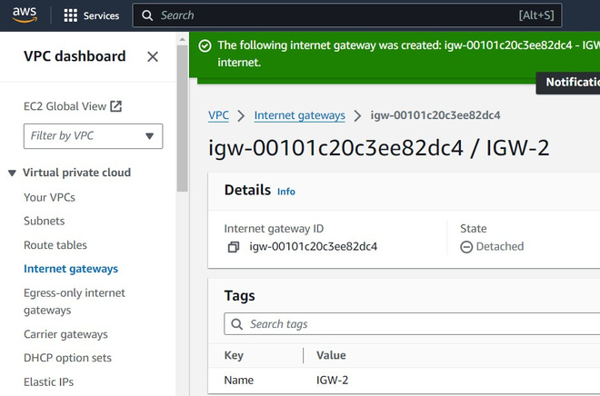
Subnets & IGW

Slide 10
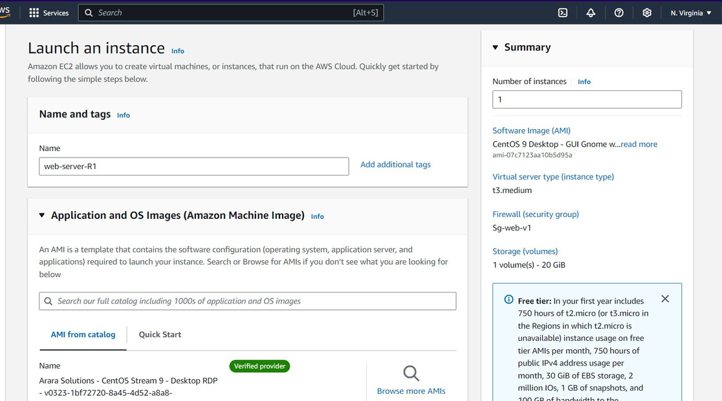
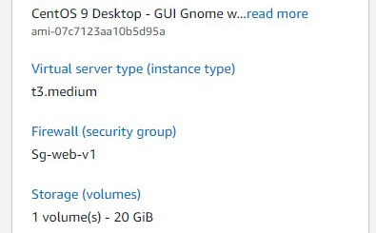
2
EC
EC2 Instances
In this project, four EC2 instances were created, strategically placed within the public subnets of the two VPCs.
Instance type-t3.medium
Security Groups and Key Pair are alloted
To streamline the deployment process, AMI snapshots were utilized, enabling quick replication of configurations across different subnets.
AMI snapshots were used to create consistent backups of the instances, allowing for quick recovery or replication across different environments.

Slide 11
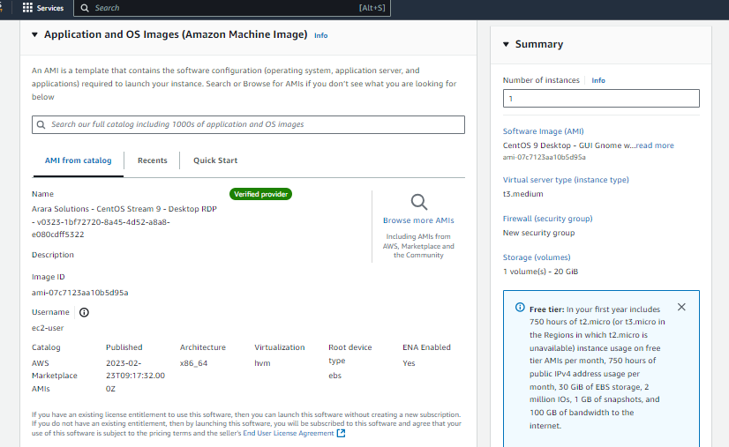
AMI
AMI- Cent OS 9- Desktop RDP
In this project, an Amazon Machine Image (AMI) was sourced from the AWS Marketplace to deploy CentOS 9 with a graphical user interface (GUI). This AMI provided a pre-configured CentOS environment, simplifying the instance launch process.
After selecting the AMI, EC2 instances were launched in the public subnet, allowing access via Remote Desktop Protocol (RDP).

Slide 12
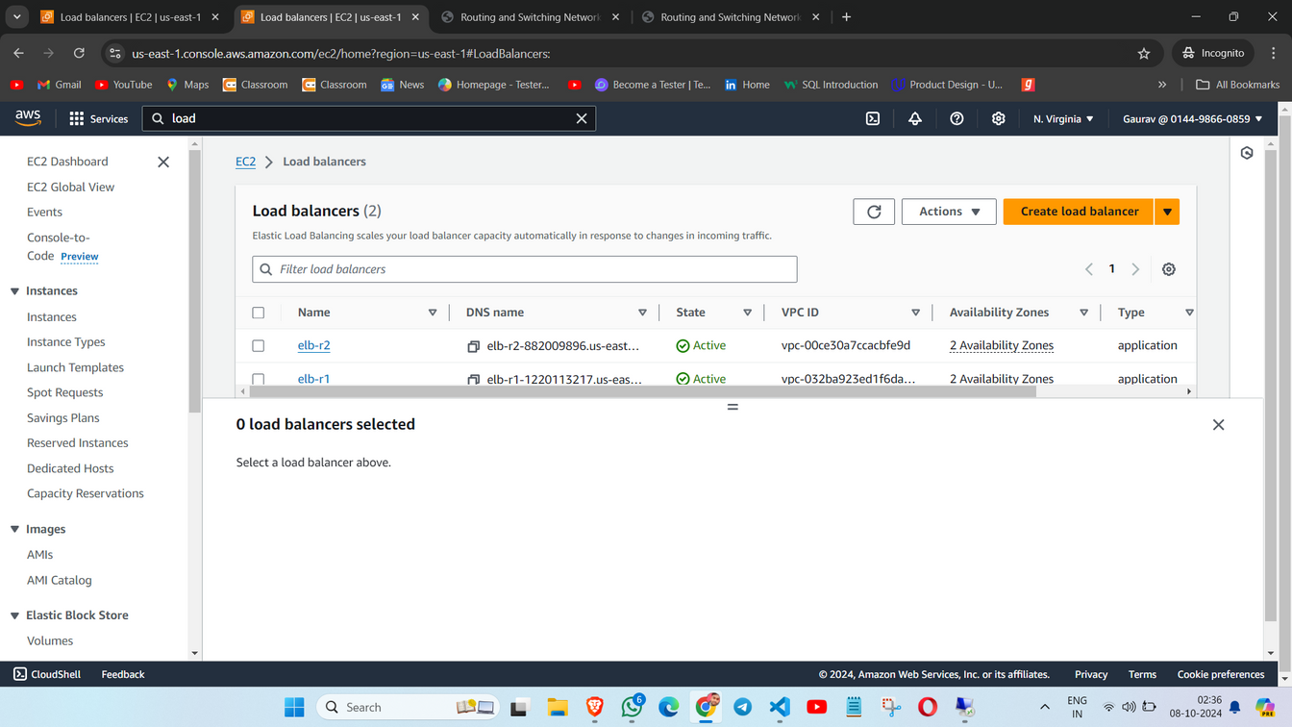
Load Balancers
Load Balancers
Load Balancers were implemented to enhance the availability and reliability of the EC2 instances deployed in the public subnets.
Traffic Distribution: They spread incoming requests evenly across instances, preventing any single instance from becoming a bottleneck.
High Availability: Load balancers route traffic only to healthy instances, ensuring continuous service even if one or more instances fail.

Slide 13
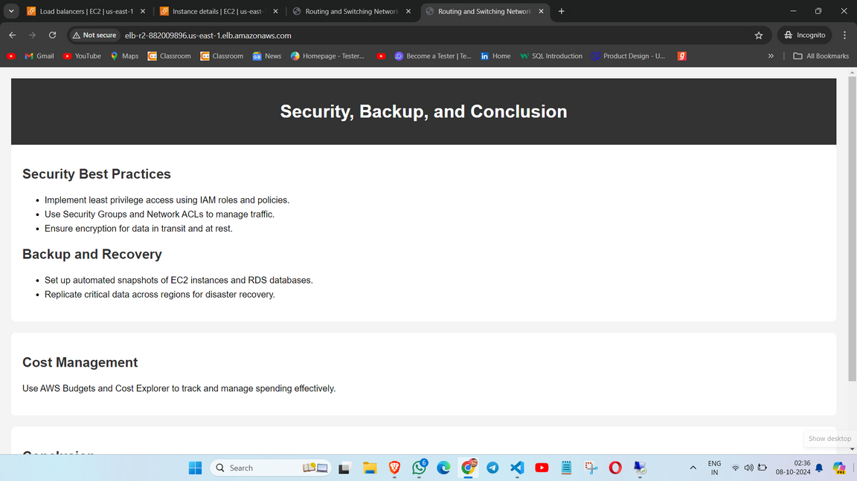
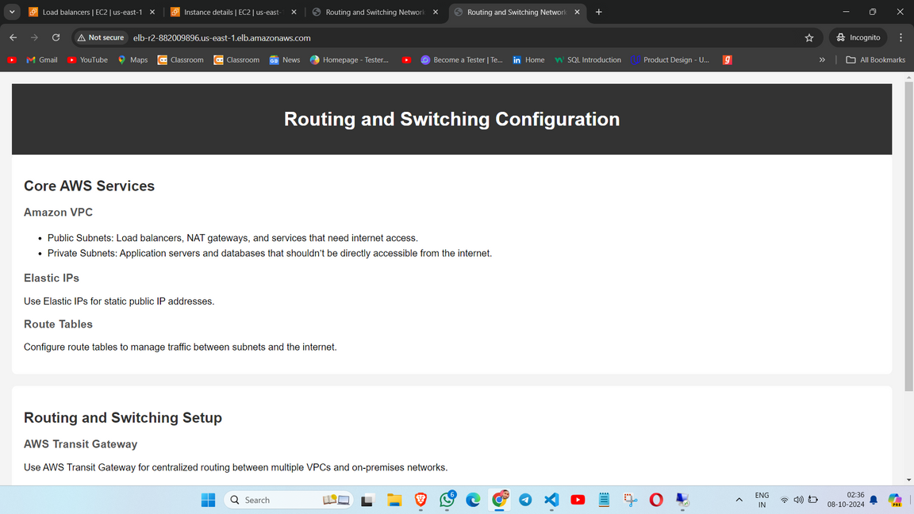
LB Implementation
Load Balancers across 2 EC2 Instances
An Application Load Balancer (ALB) was created to distribute incoming traffic across the EC2 instances. The ALB is ideal for routing requests based on content and providing advanced traffic management features
Configure Target Groups:
Each EC2 instance was registered with a target group within the Load Balancer. The target group defines the instances that the Load Balancer can route requests to.

Slide 14
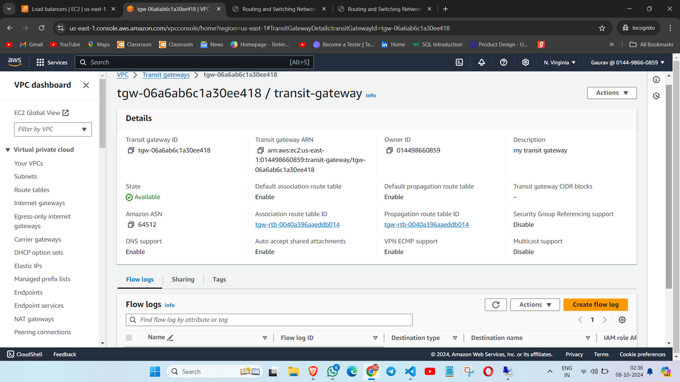
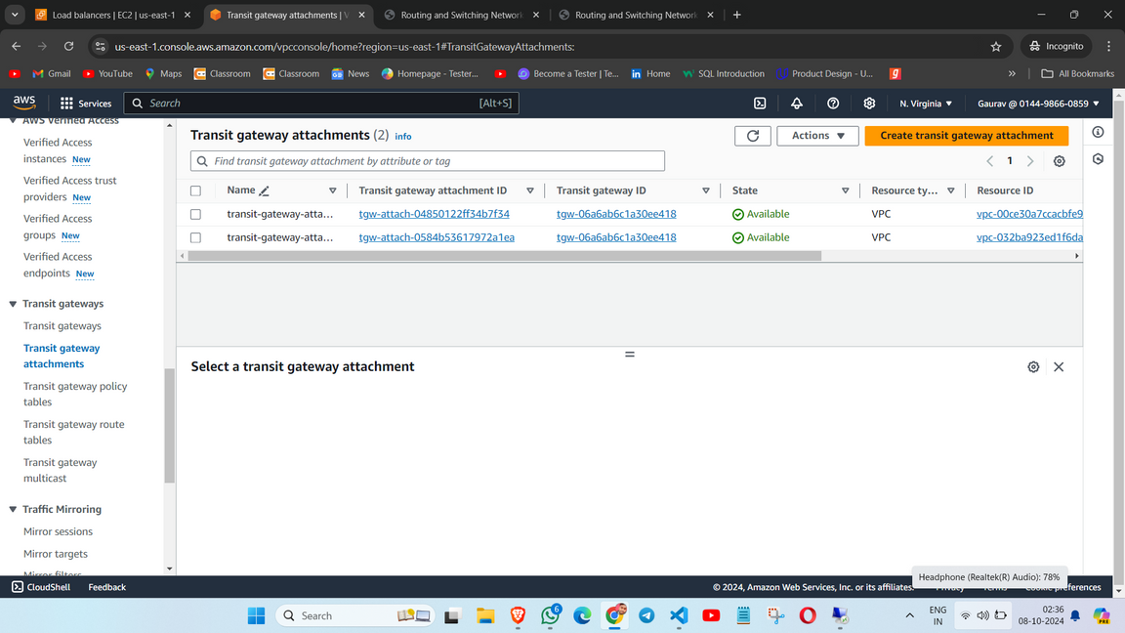
Transit Gateway
Transit Gateway
A Transit Gateway is a highly scalable service that allows interconnecting multiple VPCs, on-premises networks, or AWS accounts through a central hub. In this project, a Transit Gateway was used to connect two VPCs, enabling communication between EC2 instances located in different VPCs.
Each VPC was attached to the Transit Gateway through a VPC attachment
This setup allowed instances in one VPC to ping instances in the other, ensuring secure, scalable inter-VPC communication without needing direct peering.

Slide 15
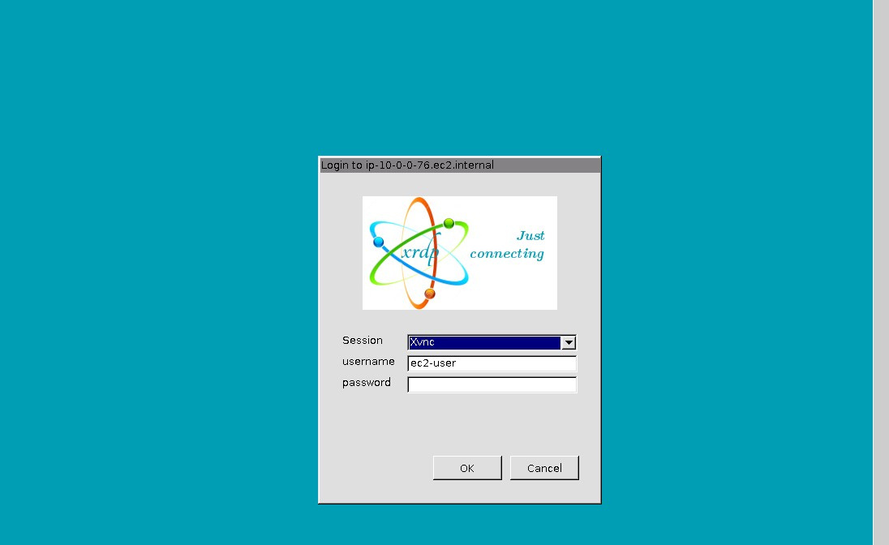
RDP - GUI
CentOS 9 with GUI:
The EC2 instances were launched using a CentOS 9 AMI from the AWS Marketplace, which included a pre-installed graphical user interface. This GUI allowed users to interact with the operating system and applications in a visually intuitive manner.
RDP was enabled on the CentOS instances to facilitate remote access. This protocol allows users to connect to their instances from local machines, providing a seamless way to manage applications and perform administrative tasks.

Slide 16
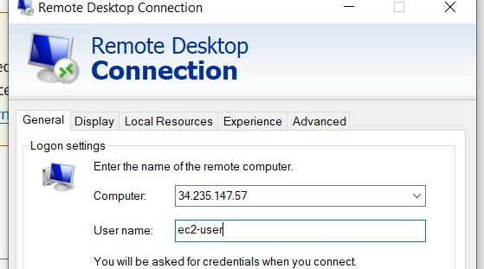
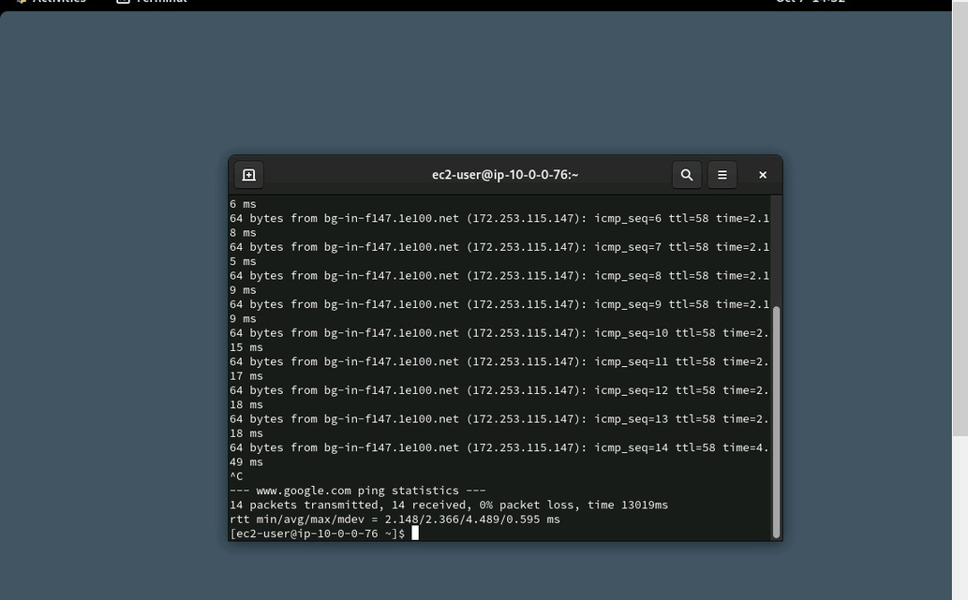
RDP
lOGGING IN RDP
We configured RDP on CentOS 9 by installing the xrdp package, setting up a graphical user interface (GUI), and enabling RDP access through security groups and firewall rules.
To verify internet connectivity, we tested the setup by pinging Google from the terminal within the GUI.

Slide 17
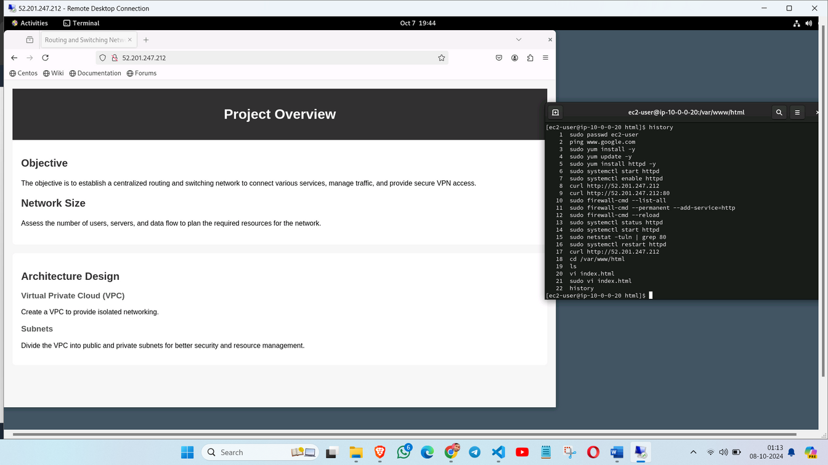
HTML Config.
Html and Testing
We created multiple HTML files for each EC2 instance, each containing different content to demonstrate dynamic serving. The HTML files were stored in the web server's document root directory, typically located at /var/www/html.
An HTTP server, such as Apache or Nginx, was installed and configured to serve the HTML files. Entered the public IP address of the EC2 instance in the browser's address bar, followed by the path to the specific HTML file (e.g., http://your-instance-public-ip/yourfile.html).

Slide 18
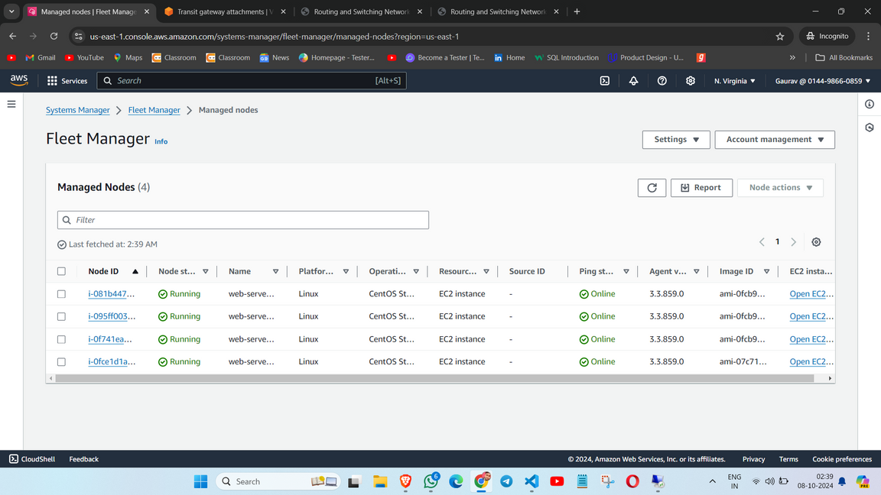
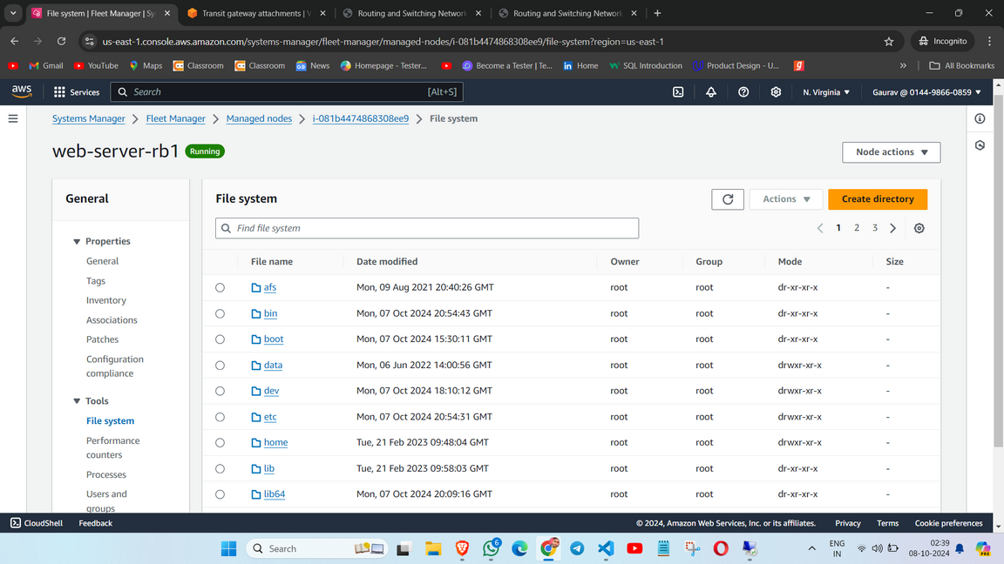
Systems Manager
Fleet Manager
AWS Systems Manager is a management service that allows users to gain operational insights and control over their AWS resources. It provides a unified user interface for managing and automating tasks across AWS services.
SSM Agent Installation: We enabled the Systems Manager agent on our CentOS instances, which allows secure communication between the instances and Systems Manager.
Fleet Manager allows us to view and manage the inventory of EC2 instances, including their status, configuration, and associated tags.

Slide 19
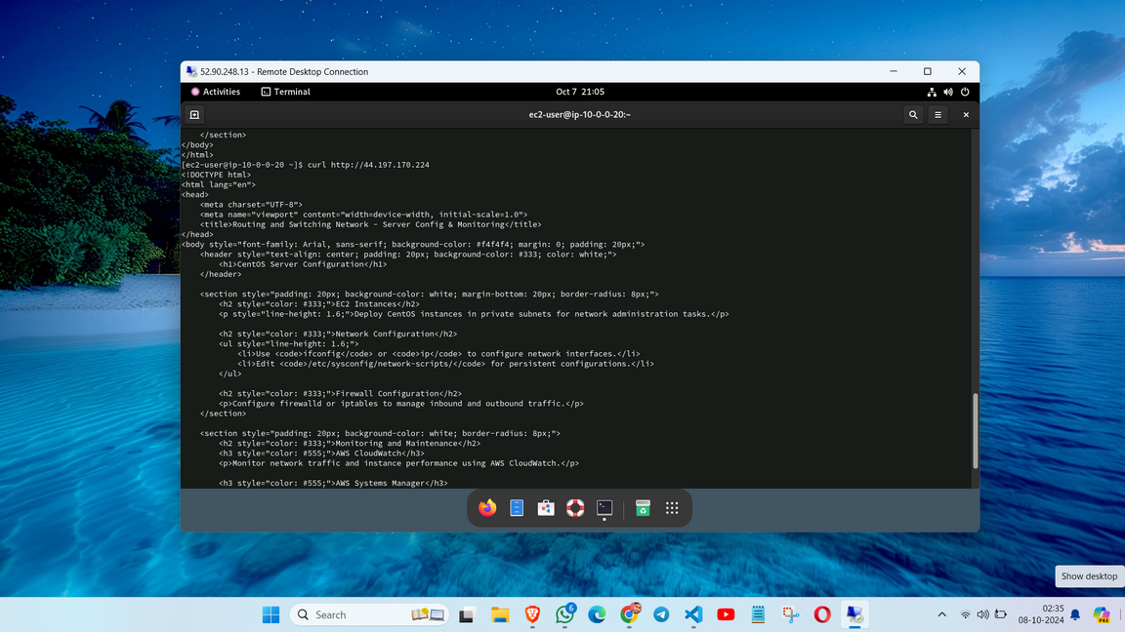
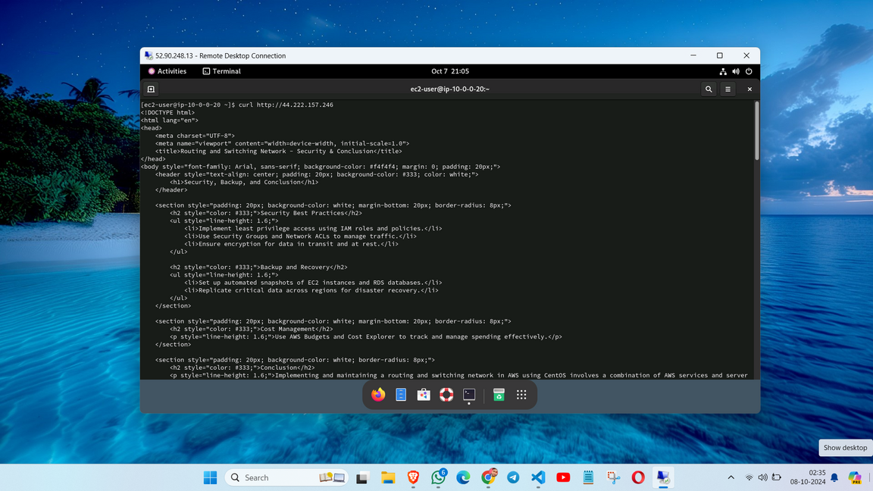
Testing Routing
Test- Pinging
In this project, we successfully established routing and connectivity between EC2 instances located in different VPCs.
Successful Ping: We demonstrated connectivity by pinging an EC2 instance in another VPC from one instance in present VPC.
Accessing HTML Content: After establishing a connection, we accessed the HTML content hosted on the second EC2 instance.

Slide 20
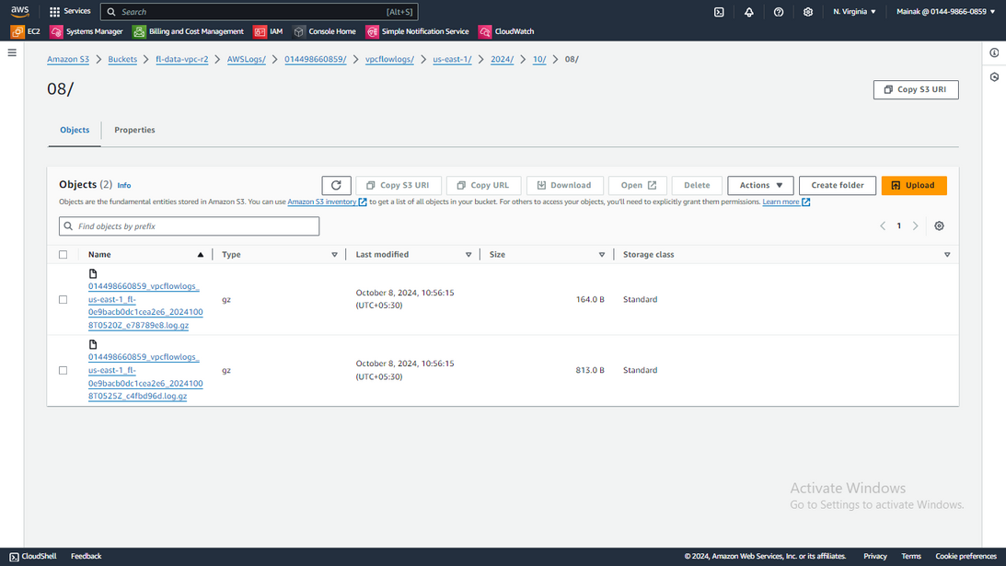
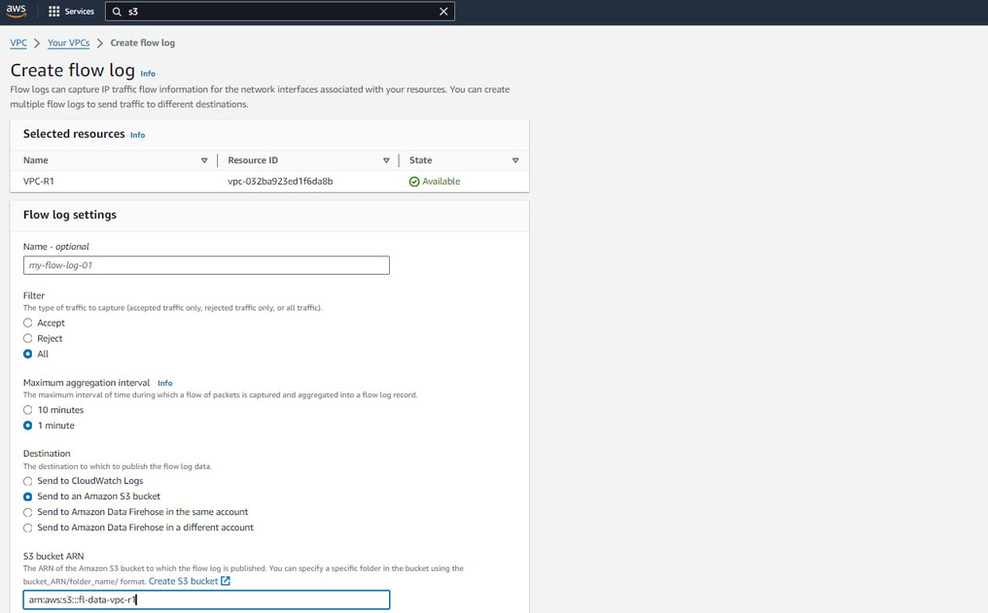
VPC -Flow Logs
Flow Logs
VPC Flow Logs is a feature in AWS that enables the capture of information about the IP traffic going to and from network interfaces in your VPC. They help in monitoring, troubleshooting, and ensuring security compliance.
The captured flow logs were sent to an Amazon S3 bucket for storage and further analysis. This approach provides an efficient way to retain and manage logs over time.

Slide 21
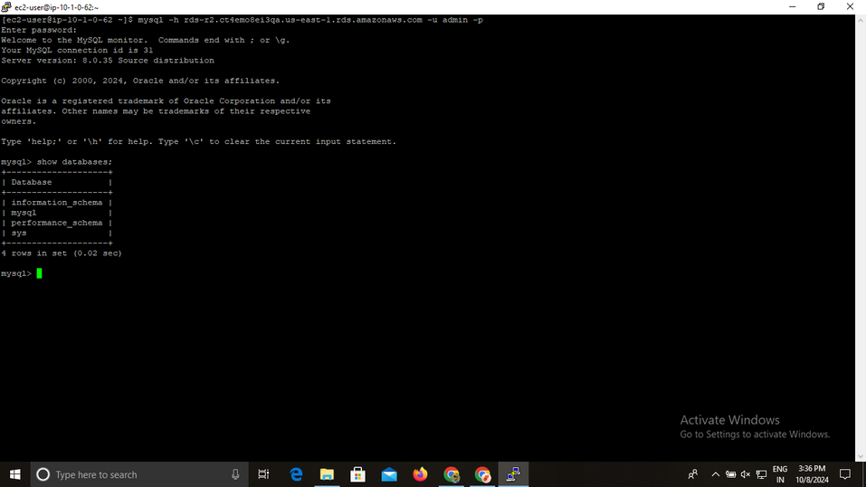
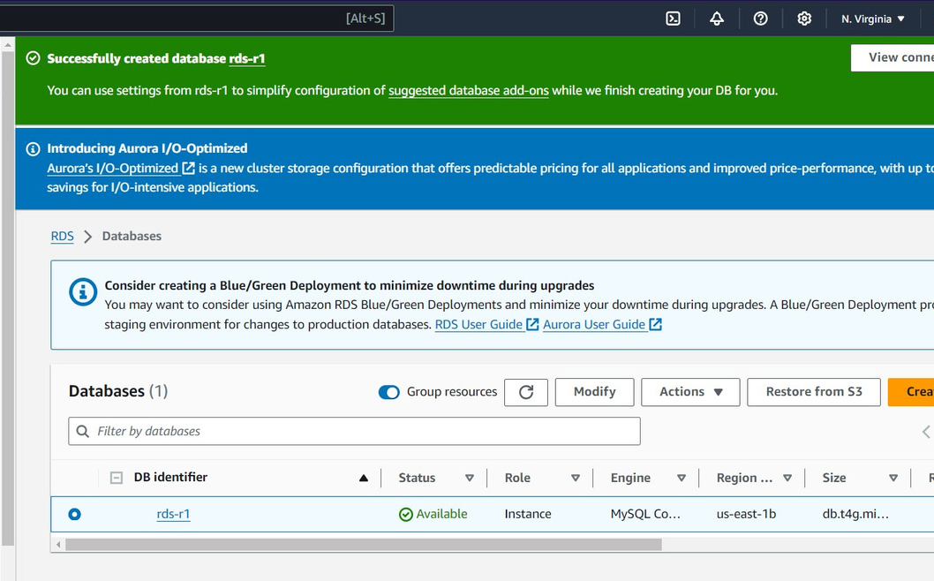
RDS-MySQL
RDS & Endpoints
Amazon RDS is a managed database service that simplifies database setup, operation, and scaling in the cloud. It supports multiple database engines, including MySQL, PostgreSQL, Oracle, and SQL Server, allowing users to focus on application development rather than database management.
In this project, we leveraged the Amazon RDS (Relational Database Service) and its endpoint for seamless database connectivity and management from our CentOS 9 EC2 instances through Remote Desktop Protocol (RDP). It acts as the connection point for applications or clients to interact with the database.

Slide 22
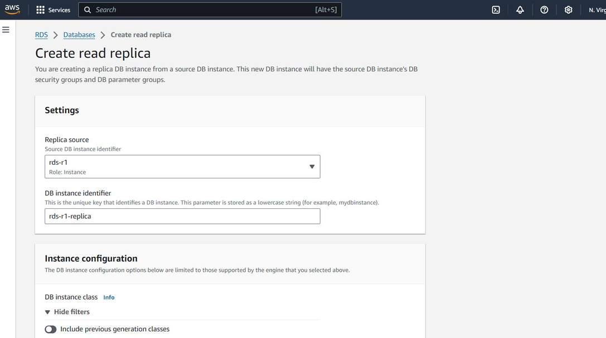
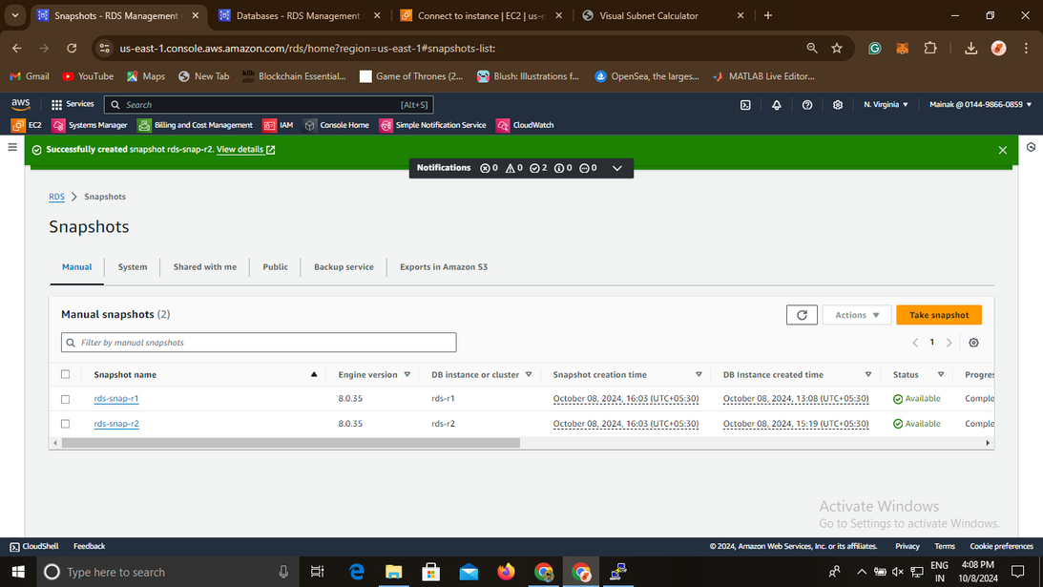
RDS Read Replicas
Read Replicas
In this project, we implemented Amazon RDS with two read replicas to enhance the performance and scalability of our database operations.
The use of read replicas reduced latency and improved response times for read operations, enhancing the user experience.

Slide 23
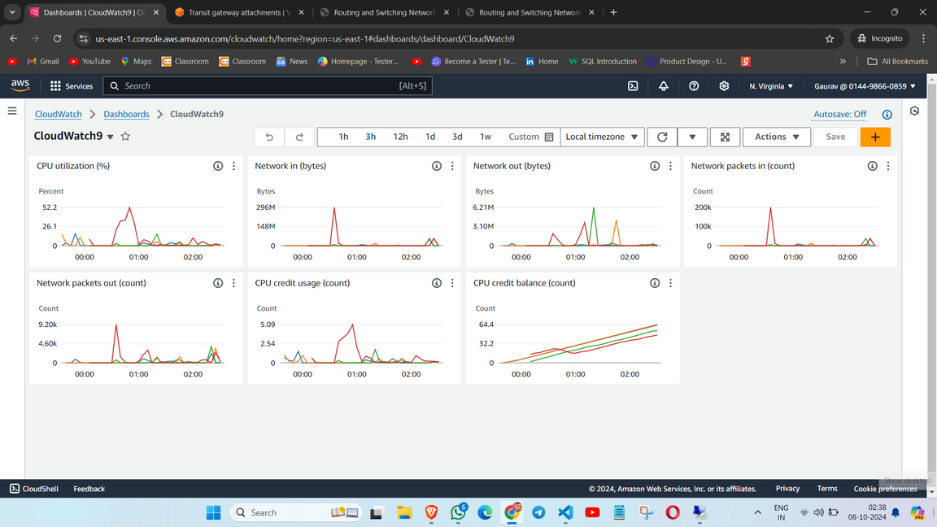
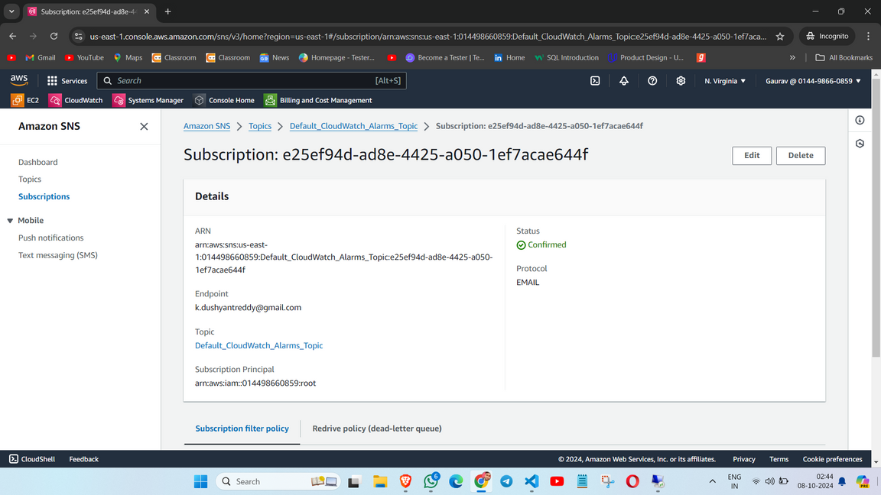
CloudWatch &
SNS
Implementation
In this project, we integrated AWS CloudWatch and Amazon Simple Notification Service (SNS) to enhance monitoring and alerting capabilities Metrics Monitoring: We utilized CloudWatch to track metrics such as CPU utilization, memory usage, disk I/O. Custom CloudWatch alarms were configured to trigger notifications based on specific thresholds.We configured SNS to send notifications based on CloudWatch alarms, ensuring that our team was promptly informed of critical events.

Slide 24
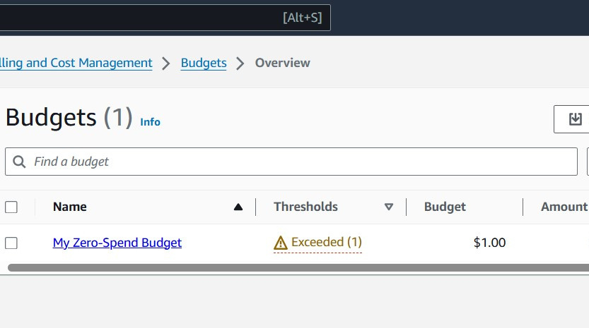
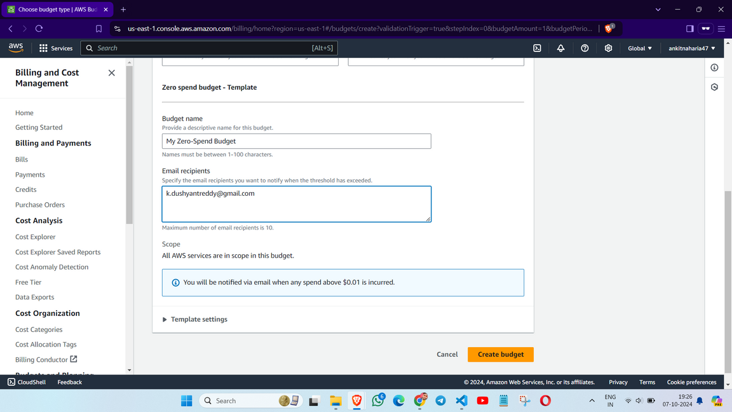
Budgets
About
AWS Budgets is a cost management tool that allows users to set custom cost and usage budgets for their AWS accounts. It helps track spending against defined limits and provides alerts when thresholds are exceeded. We created budgets based on projected costs for specific AWS services, projects, or linked accounts, enabling granular control over expenditures.AWS Budgets allows us to set alerts that notify stakeholders via email or SNS when spending approaches or exceeds budget limits, ensuring transparency and timely action.

Slide 25
Future Scope
The future goals of this project can evolve to address changing business requirements, adopt new technologies, and maintain a competitive edge while ensuring a stable and scalable network infrastructure.
Future Goals for the Centralized Network:
Global Expansion: Extend the network to new regions for better performance and international reach.
Enhanced Security: Integrate advanced security tools and automate compliance checks.
Cost Optimization: Utilize cost-monitoring tools and automate resource scheduling.
AI Integration: Leverage machine learning for traffic analysis, anomaly detection, and predictive scaling.
Automated Response: Implement self-healing infrastructure and automated incident handling.
Hybrid and Multi-Cloud Support: Expand to support hybrid environments with seamless cloud integrations.
Monitoring Improvements: Enhance monitoring and logging for better issue detection.
DevOps Support: Automate deployments and updates through CI/CD and infrastructure-as-code.
These goals aim to enhance scalability, security, and cost-efficiency while supporting future growth.

Slide 26
Conclusion
This project successfully demonstrated the implementation of a comprehensive cloud infrastructure on AWS, utilizing key services such as IAM, VPC, EC2, RDS, Systems Manager, and others. We created a secure and scalable environment with two VPCs, enabling seamless traffic routing between EC2 instances using Transit Gateway. EC2 instances, deployed in both public subnets, hosted HTML pages that were successfully accessed across different VPCs, validating our network configuration.
Amazon RDS was implemented for database management within private subnets for enhanced security. Read replicas were set up to distribute read traffic and improve database performance. AWS Systems Manager and Fleet Manager simplified the management of EC2 instances, while CloudWatch and SNS enabled real-time monitoring and notifications to ensure efficient system operations.
The Elastic Load Balancer ensured high availability by distributing incoming traffic across multiple EC2 instances. VPC Flow Logs provided visibility into network traffic, improving security and troubleshooting capabilities. AWS Budgets and Cost Explorer were employed to track and manage cloud expenses, ensuring effective cost management.

Slide 27

Thank You
16 Oct, 2024

